Slide 1

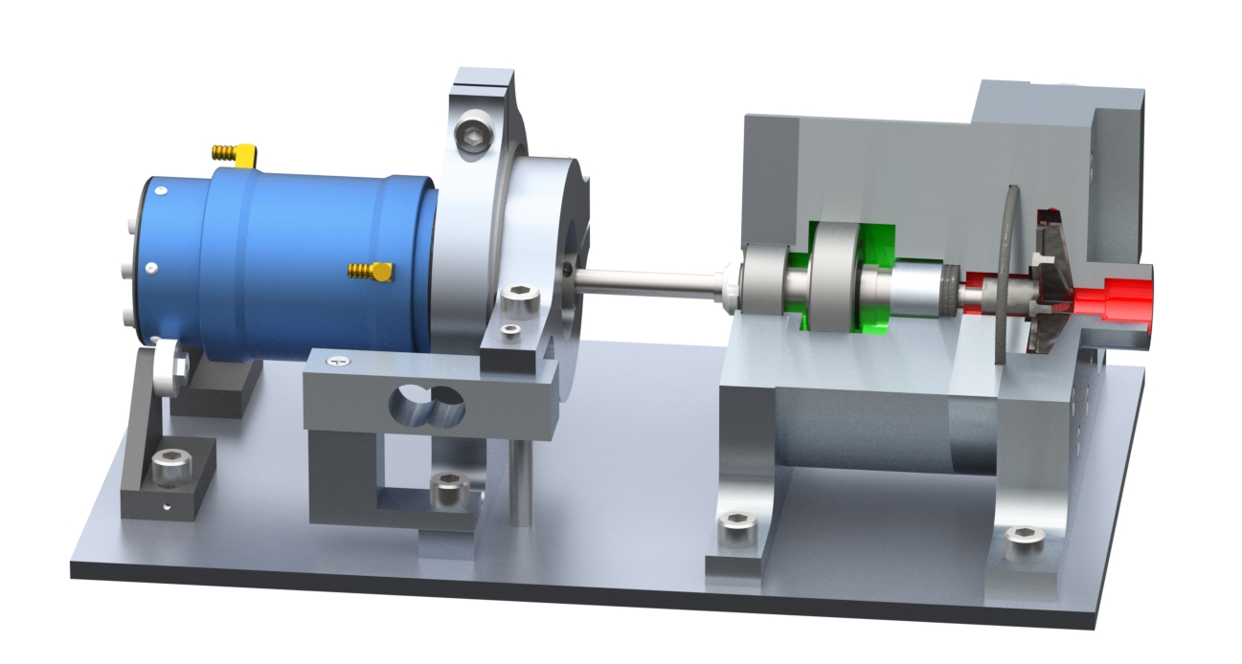
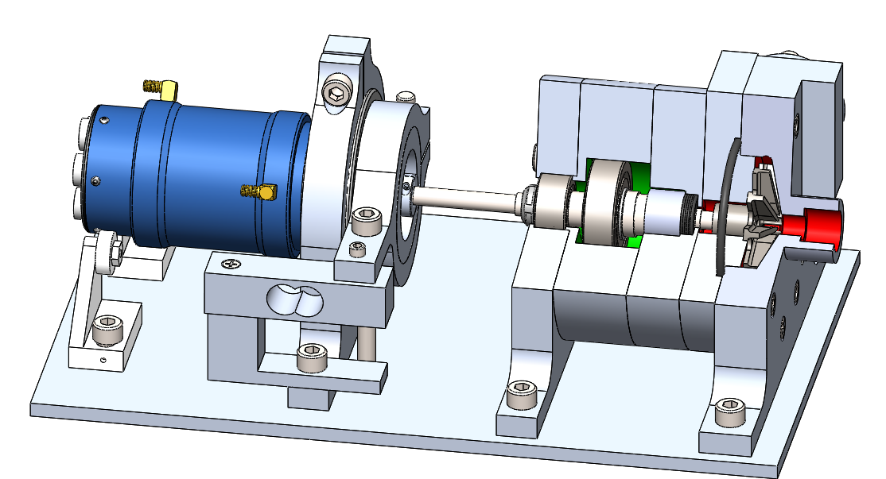
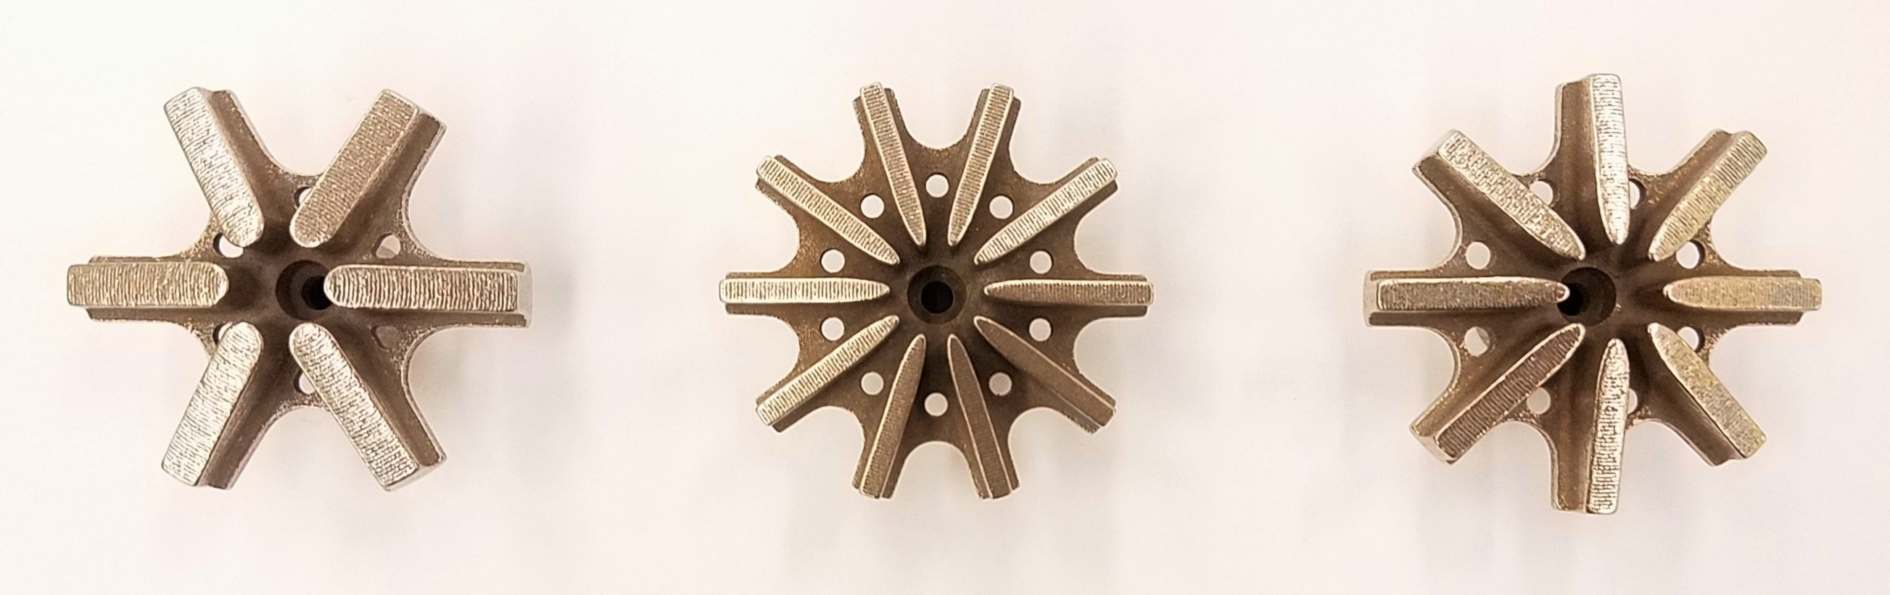
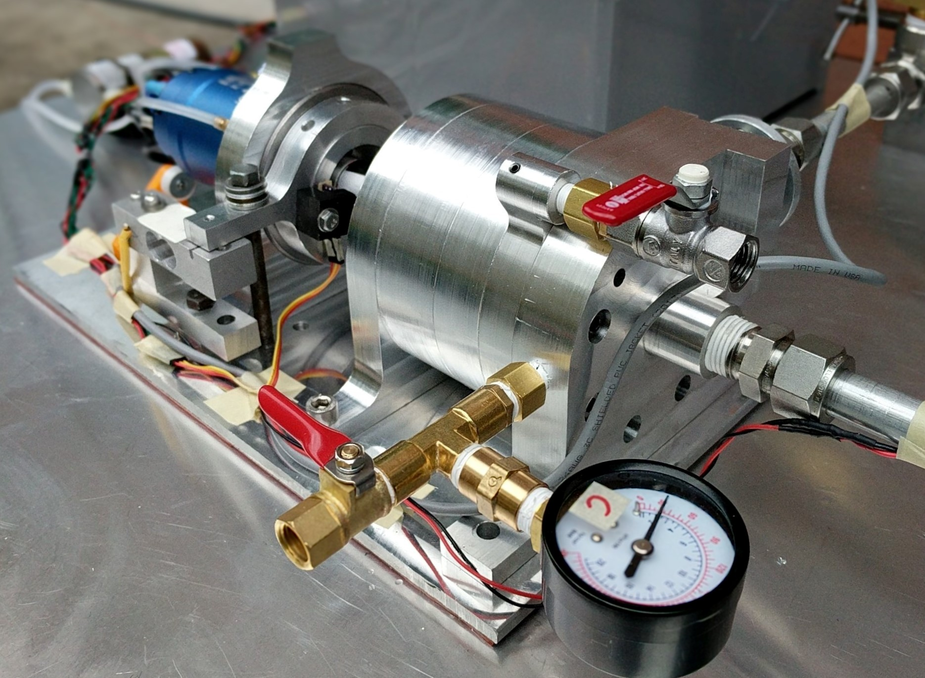
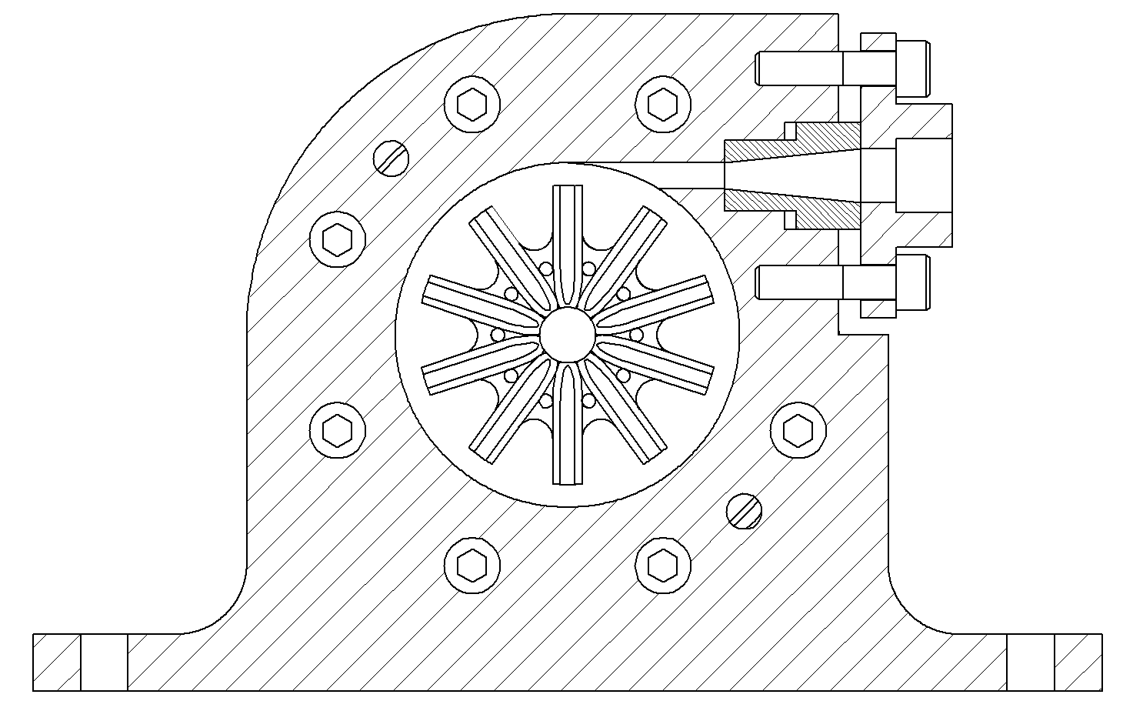
Electric Propellant Feed System (EFS)
Team Members: John C. Froehlich, Jonathan Talik, James Luce, Rawand Rasheed, Mimi Shang and Jordan Roland
Sponsor: Portland State Aerospace Society
Project Objective Statement
The goal of the EFS project is to design, build, and test an electric propellant feed system for the PSAS LV4 liquid fueled bi-propellant rocket engine prototype by June 6, 2017.
Design Features
Measured Performance
Show concrete, quantitative evidence that your device works. Show how, and to what degree, your design meets the key customer requirements. Plots, photos of the device in action, or tables of results would be good to add. However, do not cram too much information into the space
This is where you show your convincing evidence for the success of your project
Water cooled 240 amp brushless DC motor
Floating motor mount
Interchangeable diffusers
Barske straight blade impeller
Motivation
Historically, the technology used to deliver liquid propellant into a rocket’s combustion chamber has been to use complex turbopumps or heavy pressurized gas tanks. Recent advances in battery technology may allow an electric motor powered rocket propellant pump to compete with the effectiveness of a turbopump while weighing less than a pressure fed system.
The open source development of an electric motor powered, high speed centrifugal pump feed system is a step forward towards making low cost bipropellant rockets capable of reaching low Earth orbit accessible to amateurs and academic rocketry groups.
Historically, the systems to impel propellants to requirements of the combustion chamber of a liquid fueled rocket are based on the employment of turbo-pumps or a pressurized gas systems. The complexity and cost of these methods has made building a liquid fuel rocket financially and technically difficult for the amateur rocket community. However, recent technological advances in electric motors and batteries have building small and light weight electric-pump feed systems is possible.
The development and demonstration of an electronically powered, high-speed, centrifugal pump feed system is a step forward in offering low cost, open source bipropellant rockets capable of reaching low Earth orbit to amateurs and academic rocketry groups.
Motivation
Historically, the technology used to deliver liquid propellant into a rocket’s combustion chamber has been to use complex turbopumps or heavy pressurized gas tanks. Recent advances in battery technology may allow an electric motor powered rocket propellant pump to compete with the effectiveness of a turbopump while weighing less than a pressure fed system.
The open source development of an electric motor powered, high speed centrifugal pump feed system is a step forward towards making low cost bipropellant rockets capable of reaching low Earth orbit accessible to amateurs and academic rocketry groups.
Load cell for live shaft torque measurement
Thrust and radial load bearings
Shaft seal and Rulon bushing
O-ring seal
Inlet
Impellers
We chose to use unorthodox Barske straight blade impellers to meet our unusual high head, low flow requirements. Three designs were 3D printed in stainless steel.
Key Customer Requirements
Design, build and test a technology development platform for the electronic propellant feed system.
Design a pump capable of delivering 350 psi of pressure at 11 GPM to the combustion chamber.
Pump performance characterization analysis.
Scalable design for future pump iterations.
Open source documentation, design artifacts and build information.
Experiment design
In order to test our pump, we needed an elaborate testing rig.
Arduino microcontroller used for motor control and data acquisition.
Values monitored: Suction (inlet), discharge, volute and seal cavity pressures, RPM, flow rate, shaft torque.
Inlet pressure (~45 psi) provided via a 42 gallon water tank kept at constant pressure via a pressure regulator.
Motor and speed controller water cooled .
Future Work
Investigate additional design variations.
Test pump with PSAS pintle injector.
Adapt system for cryogenic propellants.
Scale design to match PSAS LV4 requirements.
Refine motor control and motor data acquisition.
Acknowledgments
PSAS Erin Schmidt Raúl Bayoán Cal Andrew Greenberg | Gerry Recktenwald Kris Auclair Mike Chung Haneef Mubarak
Project Website
https://github.com/psas/electric-feed-system

